Slide 1
Regression

Slide 2

Regression through the origin
Let $Y_{1},…, Y_{n}$ be a collection of variables we’d like to predict and $X_{1},…,X_{n}$ be predictors.
Consider minimizing
$l=\sum_{i}{{(Y_{i}−βX_{i})}^{2}={|\left|Y−βX\right||}^{2}}$

Slide 3
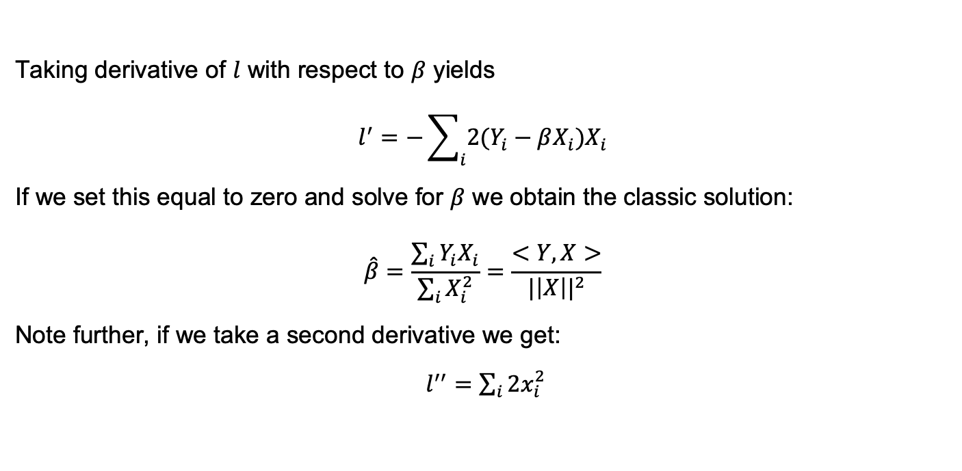
Taking derivative of $l$ with respect to $β$ yields
$$l^{′}=−\sum_{i}{2(Y_{i}−βX_{i})X_{i}}$$
If we set this equal to zero and solve for $β$ we obtain the classic solution:
$$\hat{β}=\frac{\sum_{i}{Y_{i}X_{i}}}{\sum_{i}{X_{i}^{2}}}=\frac{<Y,X>}{{|\left|X\right||}^{2}}$$
Note further, if we take a second derivative we get:
$l^{′′}=\sum_{i}{2x_{i}^{2}}$

Slide 4
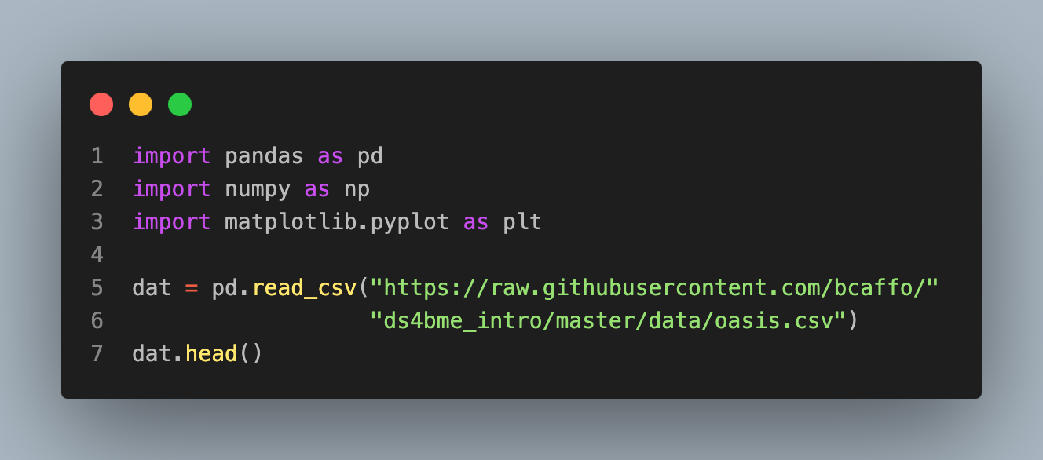

Slide 5
 | FLAIR | PD | T1 | T2 | FLAIR_10 | PD_10 | T1_10 | T2_10 | FLAIR_20 | PD_20 | T1_20 | T2_20 | GOLD_Lesions
0 | 1.143692 | 1.586219 | -0.799859 | 1.634467 | 0.437568 | 0.823800 | -0.002059 | 0.573663 | 0.279832 | 0.548341 | 0.219136 | 0.298662 | 0
1 | 1.652552 | 1.766672 | -1.250992 | 0.921230 | 0.663037 | 0.880250 | -0.422060 | 0.542597 | 0.422182 | 0.549711 | 0.061573 | 0.280972 | 0
2 | 1.036099 | 0.262042 | -0.858565 | -0.058211 | -0.044280 | -0.308569 | 0.014766 | -0.256075 | -0.136532 | -0.350905 | 0.020673 | -0.259914 | 0
3 | 1.037692 | 0.011104 | -1.228796 | -0.470222 | -0.013971 | -0.000498 | -0.395575 | -0.221900 | 0.000807 | -0.003085 | -0.193249 | -0.139284 | 0
4 | 1.580589 | 1.730152 | -0.860949 | 1.245609 | 0.617957 | 0.866352 | -0.099919 | 0.384261 | 0.391133 | 0.608826 | 0.071648 | 0.340601 | 0

Slide 6
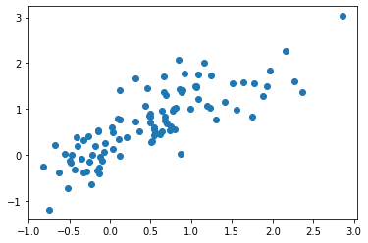
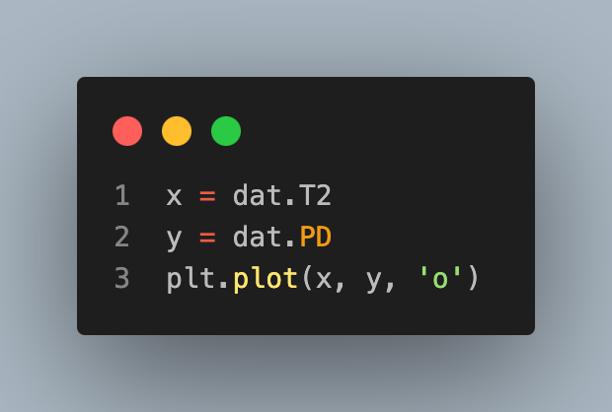
Plotting

Slide 7
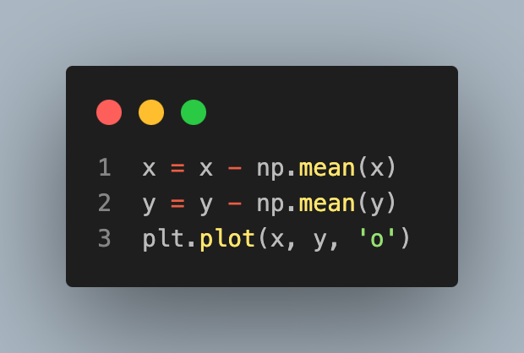
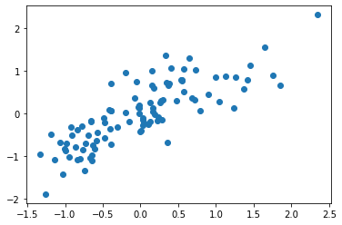
Centering

Slide 8
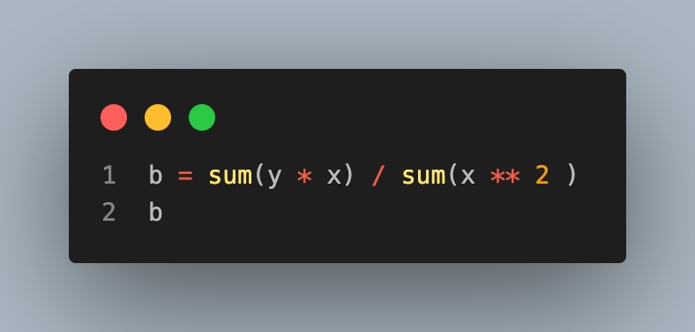
Estimation
0.7831514763656

Slide 9
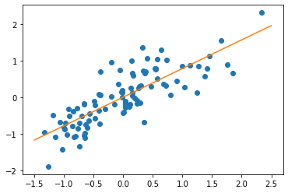
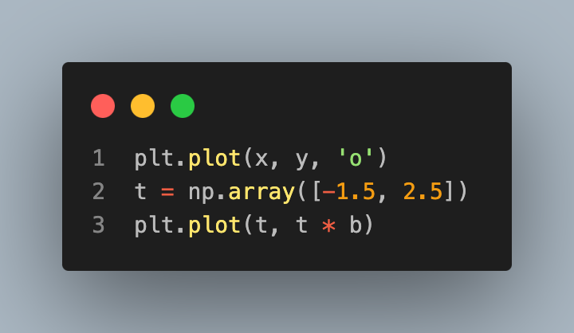
Plotting the fit

